Slide 1
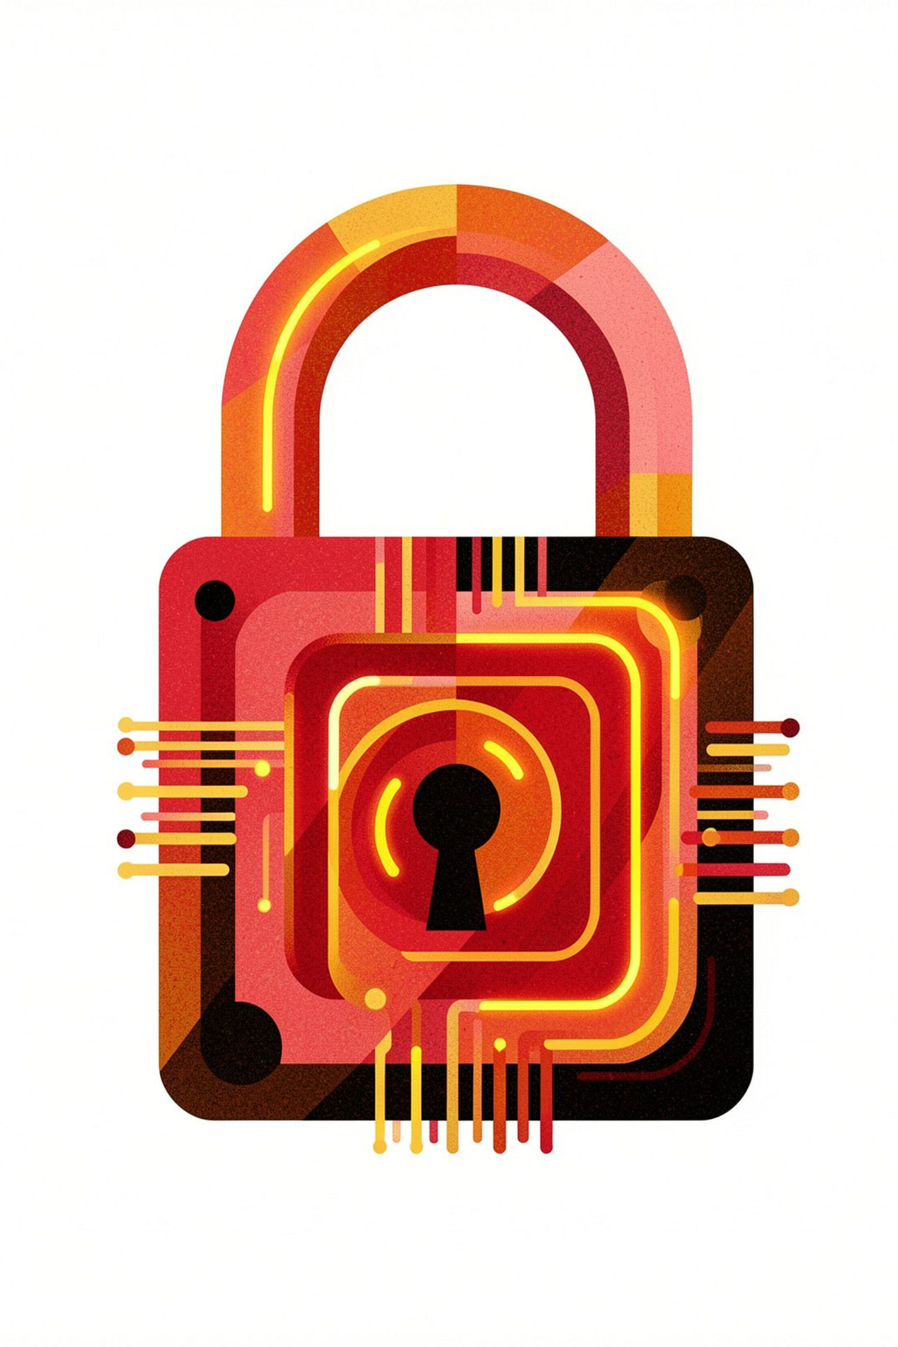
Phishing Awareness Training
Empowering you to identify and prevent cyber threats.

Slide 2

OBJECTIVE
Safeguarding Our Digital Environment
In today's interconnected world, understanding and defending against cyber threats is paramount. This training aims to equip all users with the essential knowledge and skills to navigate the digital landscape securely. Our primary objective is to cultivate a proactive defense against phishing attacks, a common and insidious form of cybercrime.
Educate Users
Identify Threats
Stay Safe
Understand the mechanics and motives behind phishing attacks.
Learn to recognize the tell-tale signs of malicious attempts.
Implement best practices to protect sensitive information and systems.

Slide 3

What Exactly is Phishing?
Phishing is a deceptive cyber attack designed to trick individuals into compromising their security. Attackers masquerade as trustworthy entities to lure victims into revealing sensitive information, clicking on malicious links, or downloading harmful files. These attacks often mimic legitimate communications from banks, well-known companies, or even social media platforms, making them difficult to detect without proper awareness.
Information Disclosure
Tricking users into revealing passwords, one-time passcodes (OTPs), or personal data.
Malicious Links
Redirecting users to fake websites designed to steal credentials or install malware.
Harmful Downloads
Coercing users into downloading viruses, ransomware, or other malicious software.

Slide 4





Understanding Diverse Phishing Tactics
Phishing isn't a single, monolithic threat; it encompasses a variety of sophisticated techniques, each designed to exploit different communication channels and psychological vulnerabilities. Recognizing these distinct types is crucial for a comprehensive defense strategy.
Email Phishing
Spear Phishing
Smishing
Vishing
The most common form, using fraudulent emails to mimic legitimate organizations.
Highly personalized attacks targeting specific individuals, often based on their roles or interests.
Phishing attempts delivered via SMS messages, often containing malicious links or requests for information.
Voice phishing, where attackers use deceptive phone calls to trick victims into revealing sensitive data.
Clone Phishing
Recreating a legitimate email that was previously sent, but with malicious links or attachments.

Slide 5
Spotting Phishing in Your Inbox
Your email inbox is a primary battleground for phishing attacks. Learning to identify the subtle, and sometimes not-so-subtle, warning signs can save you and the organization from significant harm. Always approach unexpected or suspicious emails with a critical eye.
Unknown Sender Address
Always check the full email address, not just the display name. Look for inconsistencies or unusual domains.
Spelling or Grammar Mistakes
Professional organizations rarely send emails riddled with errors. These are red flags indicating a potential scam.
Urgent or Threatening Messages
Phishers often create a sense of panic or urgency ("Act now!", "Account suspended!") to bypass critical thinking.
Suspicious Links
Hover your mouse over any link (without clicking!) to see the actual URL. If it doesn't match the expected domain, it's likely malicious.
Unexpected Attachments
Be wary of unsolicited attachments, especially if they are executable files (.exe) or compressed archives (.zip).

Slide 6
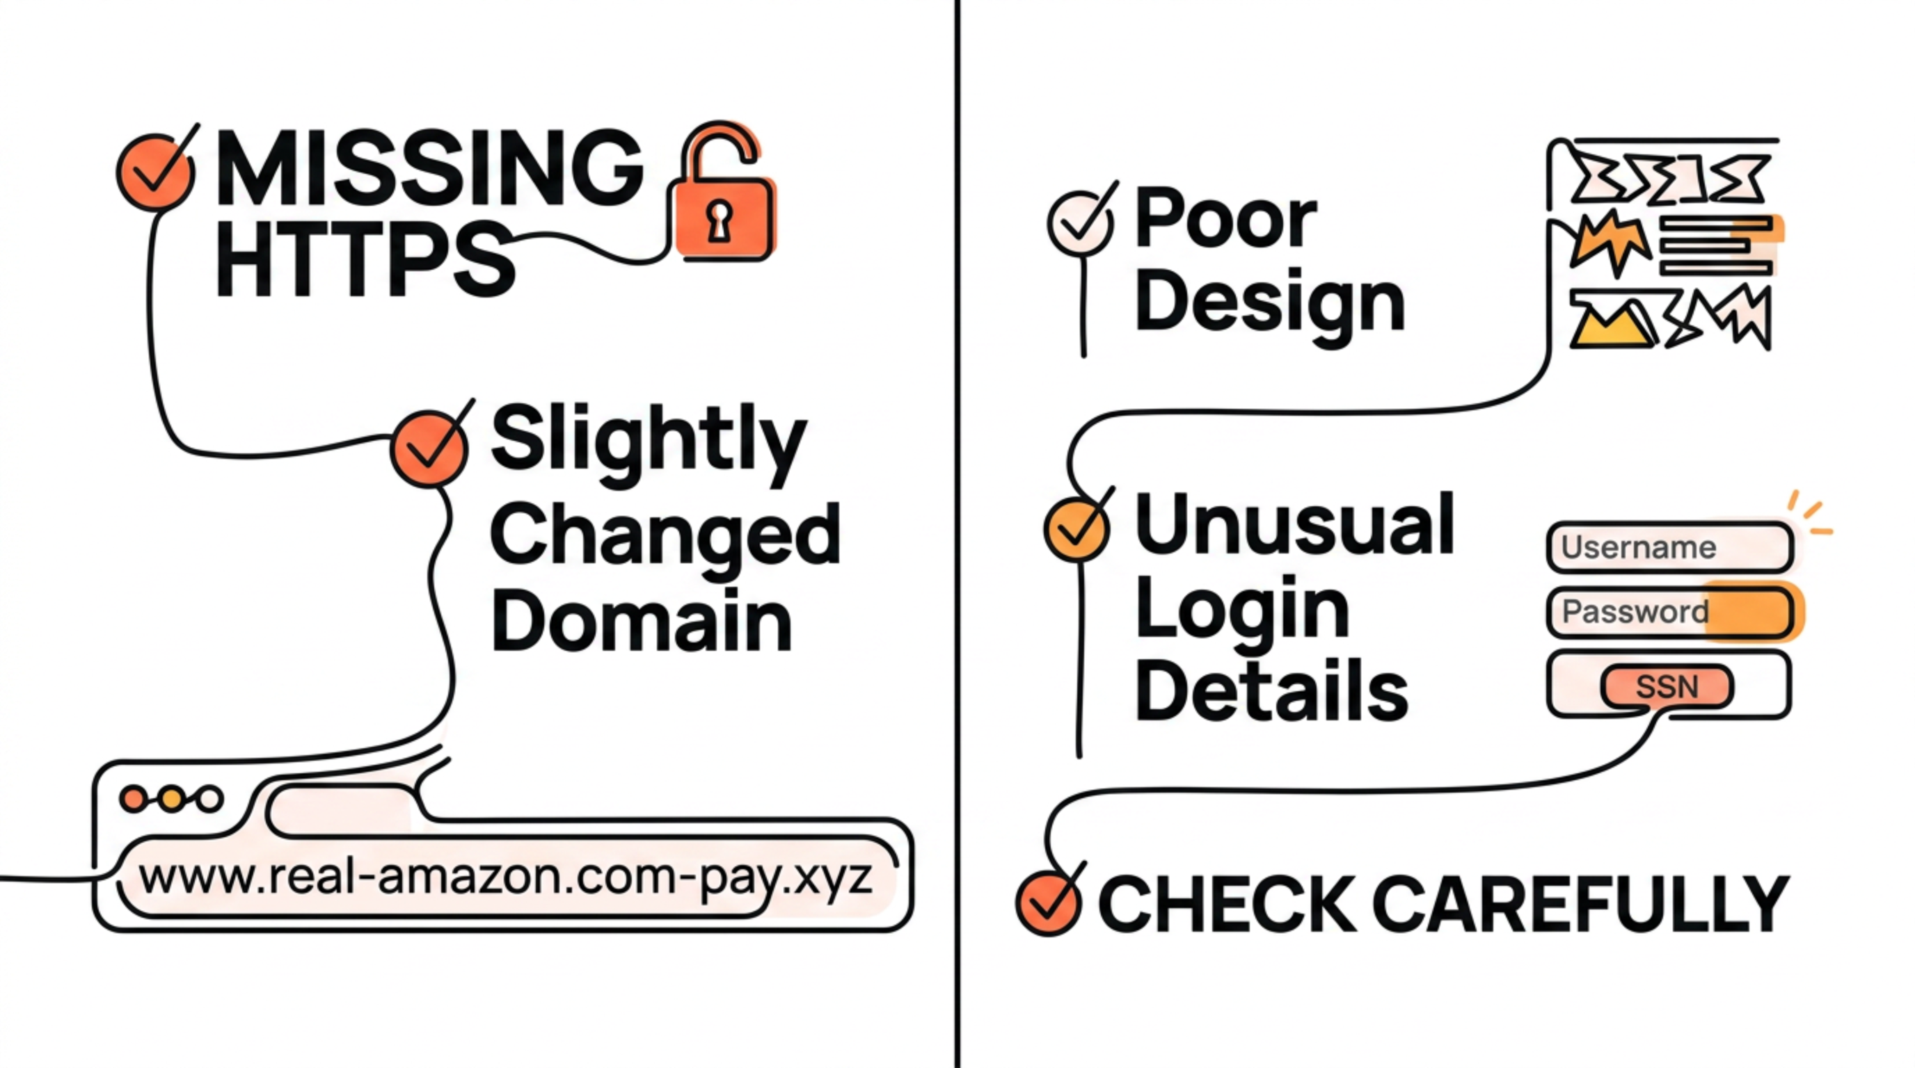
Identifying Counterfeit Websites
Phishing attacks often redirect users to fake websites designed to look identical to legitimate ones. These sites are crafted to steal your login credentials or other personal information. Knowing what to look for can prevent you from falling victim to these convincing replicas.
Always double-check the URL in your browser's address bar. Even a single character difference can indicate a fraudulent site. If something feels off, trust your instincts and navigate directly to the official website instead of clicking links.

Slide 7





Social Engineering: Manipulating Human Behavior
Phishing thrives on social engineering, a psychological manipulation that tricks users into performing actions or divulging confidential information. Attackers exploit natural human tendencies like trust, fear, and curiosity to bypass logical reasoning.
Authority
Urgency
Pretending to be bank or admin.
"Your account will be blocked!"
Fear
Threatening consequences.
Trust
Acting as a known contact.
Curiosity
"You won a prize!"
Understanding these psychological triggers is your first line of defense. When an email or message plays on these emotions, pause and critically evaluate the situation before responding.

Slide 8
Best Practices for Digital Safety
Proactive measures are your strongest defense against phishing. By integrating these best practices into your daily digital habits, you significantly reduce your vulnerability to cyber attacks and protect both your personal and organizational data.
1
2
Do Not Click Unknown Links
Verify Sender Before Responding
Always manually type URLs or use bookmarks for sensitive sites.
If unsure, contact the sender through a known, legitimate channel (e.g., phone call, official website).
3
4
Use Strong, Unique Passwords
Enable 2-Factor Authentication (2FA)
Combine uppercase, lowercase, numbers, and symbols. Avoid reusing passwords across different accounts.
Adds an extra layer of security, requiring a second verification method beyond just a password.
5
6
Never Share OTPs or Passwords
Keep Software Updated
Legitimate entities will never ask for your password or OTP via email, text, or phone call.
Regularly update your operating system, web browsers, and antivirus software to patch vulnerabilities.

Slide 9

A Real-World Phishing Scenario
Consider a common phishing attempt to understand the tactics involved and how easily one can fall prey without vigilance. This example highlights the typical flow of a phishing attack and its potential consequences.
Fake Login
Link opens a counterfeit bank page
Credential Theft
Phishing Email
You enter details; attacker captures them
“Your bank account is locked. Click here.”
This scenario demonstrates how a seemingly innocuous email can lead to significant data compromise. Always remember that legitimate organizations will not ask you to verify sensitive information via unsolicited emails or links.

Slide 10
CONCLUSION
Empowered Against Phishing
Phishing attacks fundamentally rely on human error, not just technical vulnerabilities. While security systems are vital, the most effective defense is a well-informed and vigilant user base. Your awareness and careful actions are the strongest barriers against these pervasive cyber threats.
Identify Attempts
Reduce Risk
Boost Security
Users are now equipped to recognize the various forms of phishing.
A significant decrease in successful cyber attacks is expected.
Overall organizational security posture is greatly enhanced.
By staying informed, questioning suspicious communications, and adhering to best practices, you become an active participant in our collective cybersecurity. Thank you for your commitment to a safer digital environment.

